Slide 1
Building an Enterprise ETL Framework
With SSIS 2012
Chris Price
@bluewatersql

Slide 2
Introduction
Chris Price
Senior BI Consultant
Regular Speaker, Blogger, Author
Follow Me: @BluewaterSQL
Blog: http://bluewatersql.wordpress.com/
Email: cprice@pragmaticworks.com

Slide 3
Agenda
Framework Intro & Rationalization
Parts & Pieces of an ETL Framework
Demo a ETL Framework

Slide 4
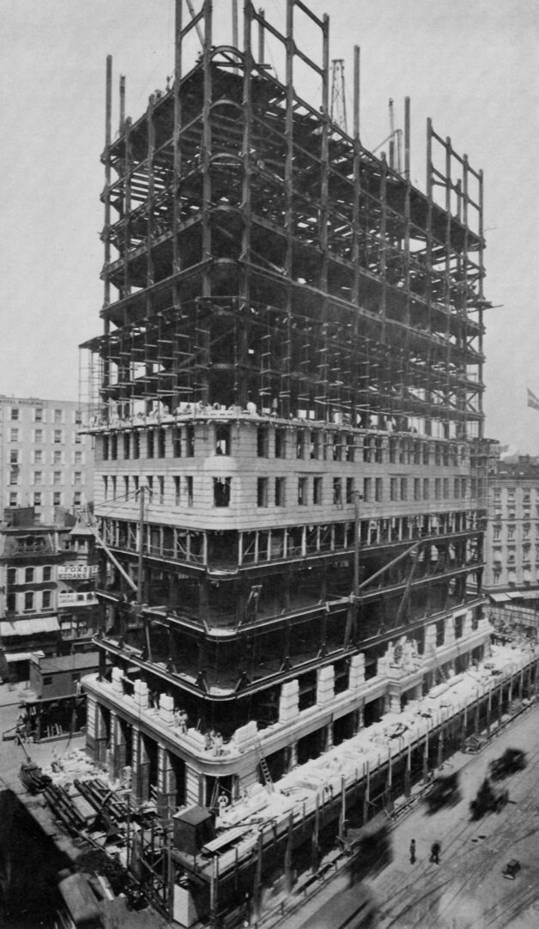
What is a Framework?
Set of common, reusable tools, processes & procedures
  DRY Principal (Do not Repeat Yourself)

Slide 5
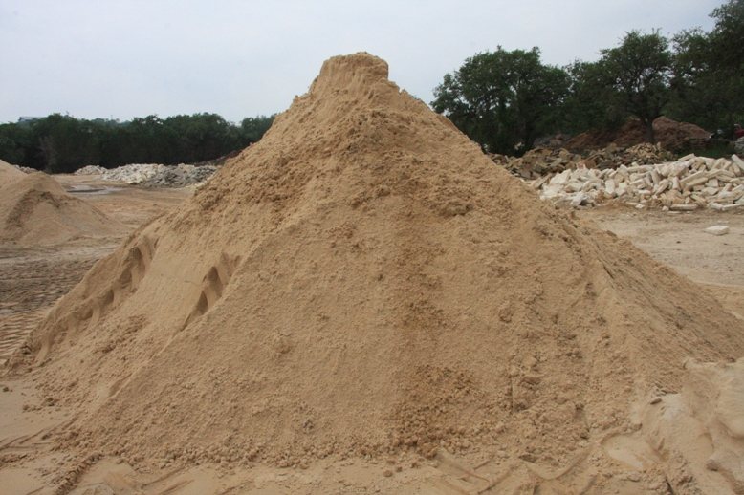
Why bother?
Standardization
Abstracts complexity and simplifies package development

Slide 6
Build or Buy or Both?
To buy….
  BIxPress
  Open Source (Codeplex)
To build….
  No one size fits all
    Business Requirements
    Compliance
    ETL Complexity
Maybe both?
  A hybrid

Slide 7
So you are going to build it….

Slide 8
Before you get started…
Event Handlers
  PreExecute, PostExecute, OnVariableChange, OnError, OnWarning, OnInformation
Logging (Built-In)
  SSIS Catalog
Configuration (Built-In)
  Parameters (2012)
Project Deployment Model (2012)
  How you locate/execute child packages

Slide 9
Framework Parts & Pieces
Logging/Auditing
Configuration
Notifications
Fault Tolerance & Recoverability
Orchestration & Parallelism
Scheduling
Reporting/Monitoring

Slide 10
Logging & Auditing
Built-In Logging (SSIS Catalog)
  When did the process start/finish?
  Was the process successful?
  Why did the process fail?
Auditing
  How many rows where loaded/inserted/updated?
  Data lineage?

Slide 11
Configuration
Built-In Configuration Options
  XML/SQL Server
  Parameters (2012)

Slide 12
Notifications
Windows Event Logs
  Monitored by MOM/NetIQ/etc
Database Table
  Tied to dashboard or report
Email
  Not a big FAN of this option…..

Slide 13
Fault Tolerance & Recoverability
Transactions
Restartable (Pattern)
Checkpoints

Slide 14
Orchestration & Parallelism
Package Precedence
  Extract -> Load
Parallelism

Slide 15
Scheduling
SQL Server Agent
Custom
  Mimic scheduling in SQL Server Agent

Slide 16
Reporting
Reports
  Configuration
  Execution
  Performance (Trends)
  Errors
Dashboards
  Daily

Slide 17
Design a Framework
Framework Repository
  Package Metadata
  Configurations
  Logs (Can be split to its own repository)
Framework Packages
  Handle notifications, recoverability, orchestration, parallelism, scheduling
Package Templates
  Logging, Auditing, Configuration, Fault Tolerance

Slide 18
Architecture Terminology
Application Scheduler
Application
  Logical collection of SSIS packages
TaskFactory
Task
  A discrete SSIS package
Template

Slide 19
What’s next?
Meta-data Driven ETL
Dynamic Package Generation
Asynchronous Package Execution
Parallel Channel Balancing
Scale Out Support

Slide 20
Questions/Comments
Presentation & Demo available at:
http://bluewatersql.wordpress.com/resources/

Slide 21
Thank You and See You Soon!
Chris Price (@BluewaterSQL)
http://bluewatersql.wordpress.com/
cprice@pragmaticworks.com

